Slide 1


SECOND HAND MARKET (Old product buy/sell Website using MEAN Stack)
Designed By:
Muskan Upadhyay
(181500407)
Nitin Kumar Singh
(181500434)

Slide 2
Introduction to MEAN
The term MEAN stack refers to a collection of JavaScript based technologies used to develop web applications.
MEAN Stands for MongoDB, Angular, Node.js, Express.
MEAN stack provides us an efficient and easy way to develop Single Page Web Applications.
MEAN stack applications are flexible, scalable, and extensible, making them the perfect candidate for cloud hosting.

Slide 3
What is MongoDB ?
MongoDB is an open source, NoSQL database designed for cloud applications.
It uses object-oriented organization instead of a relational model. The format of storage is called BSON(Binary JSON)
MongoDB is well known for its ability to manage large amounts of data without compromising on data access.
Everything in MongoDB is stored in key : value format.

Slide 4
What is Express ?
Express is a minimal and flexible Node.js web application framework that provides a robust set of features for web and mobile applications.
Forming the backend of the MEAN stack, Express handles all the interactions between the frontend and the database, ensuring a smooth transfer of data to the end user.
Express offers excellent error handling and templating functionality to aid your development.
It defines a routing table which is used to perform different actions based on HTTP method and URL.
It allows to dynamically render HTML Pages based on passing arguments to templates.

Slide 5
Angular 12
Angular is an open source Typescript framework by Google to build web applications. It can be freely used, changed and shared by anyone.
Angular makes it easy to create reactive Single Page Applications (SPAs).
Angular uses Microsoft's TypeScript language, which provides Class-based Object Oriented Programming, Static Typing, Generics etc. which are the features of a server-side programming language.
Angular Supports dynamic loading of the page.
Angular also provides Angular Materials to support UI development.

Slide 6
Node.js
Node.js is a cross-platform environment and library for running JavaScript applications which is used to create networking and server-side applications.
Many of the basic modules of Node.js are written in JavaScript. Node.js is mostly used to run real-time server applications.
Node.js is built on Google Chrome's V8 JavaScript Engine, so its library is very fast in code execution.
Node.js has an open source community which has produced many excellent modules to add additional capabilities to Node.js applications.

Slide 7
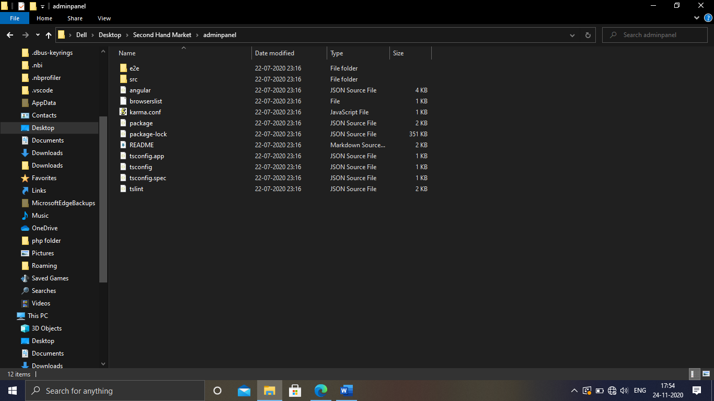
Creating a MEAN project...
Create a separate folder named Second Hand Market to store all the project files.
Go inside this folder open cmd and run the command.
ng new Frontend
The above command will create a new Angular project named Frontend containing all the files shown below.
**Important : You should have installed latest version of node and npm on your system.

Slide 8
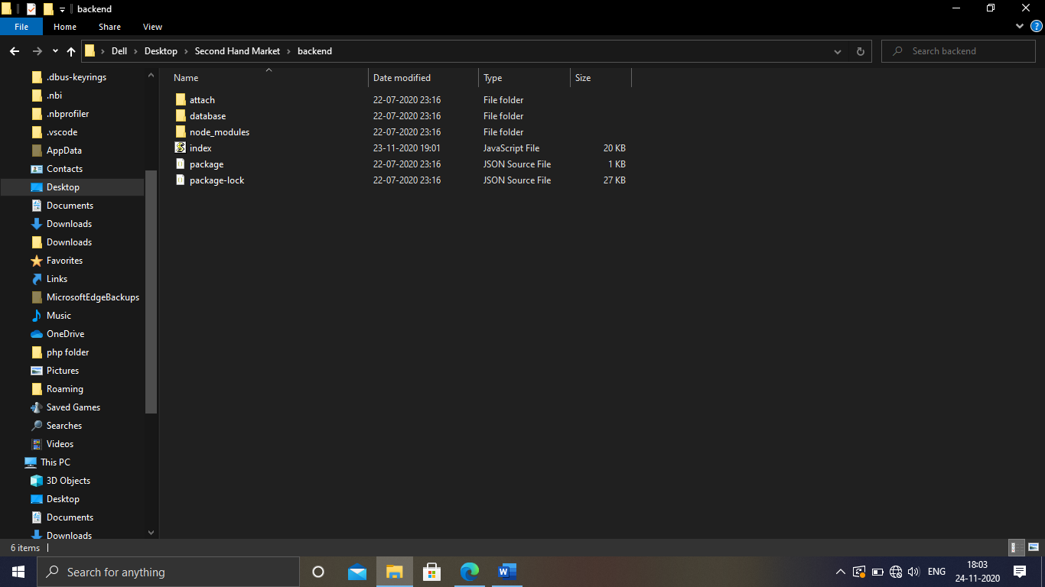
Run the same command again to generate another Angular project to design the AdminPanel.
Now create another folder inside Second Hand Market folder named Backend to store all the backend data of the site.
Go inside the Backend folder and open cmd and run the command
npm init
This will generate a package.json file, open the package.json file and set all the dependencies.
After this run the command to install all the dependencies
npm install –g node-modules
Now your backend folder will load like as shown.

Slide 9

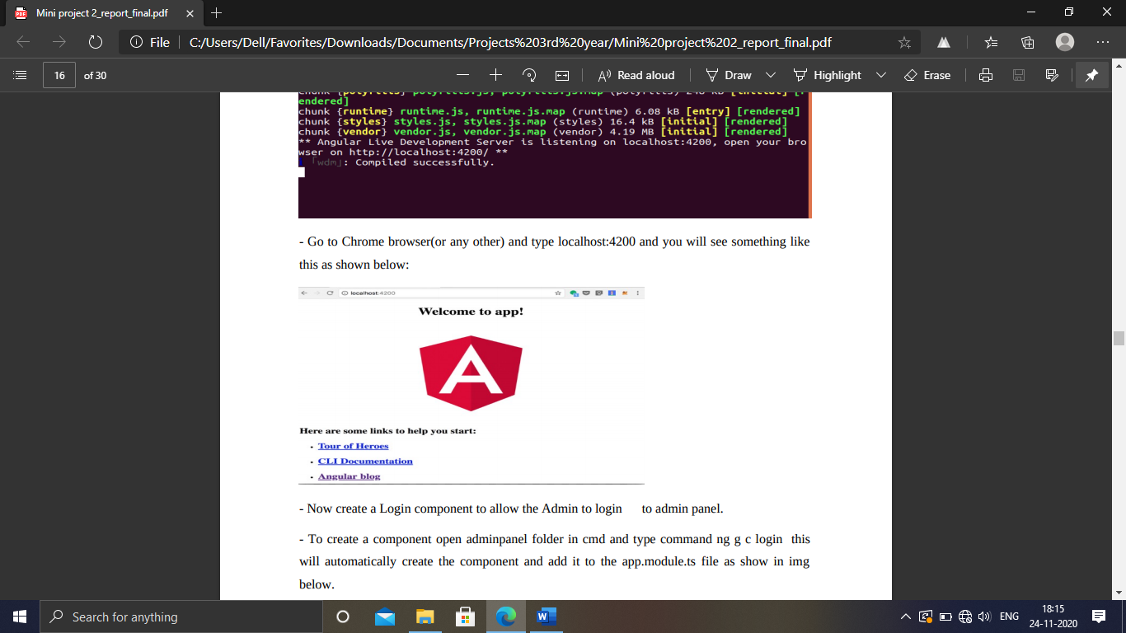
Start Coding the Web Now...
Let’s setup AdminPanel –
Go inside the AdminPanel folder and open the folder in cmd and run the command ng serve . This will compile your code.
Go to Chrome browser(or any other) and type localhost:4200 and you will see something like this as shown.

Slide 10
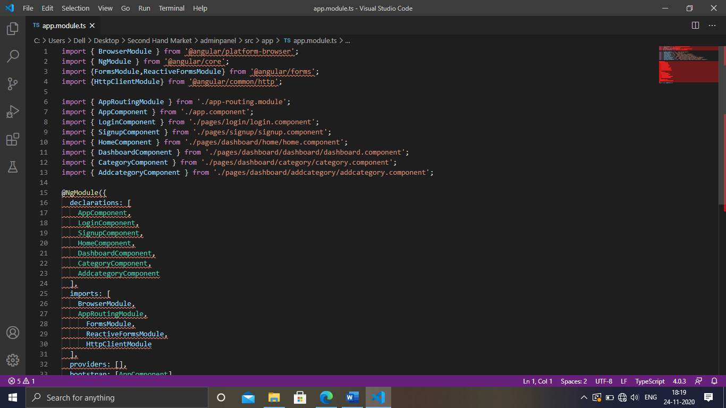
Now create a Login component to allow the Admin to login to admin panel.
To create a component open adminpanel folder in cmd and type command ng g c login this will automatically create the component and add it to the app.module.ts file as shown in image.

Slide 11
app-routing.module.ts
This file is used to store all the routes. After creating all the components needed you can give routes to them.

Slide 12
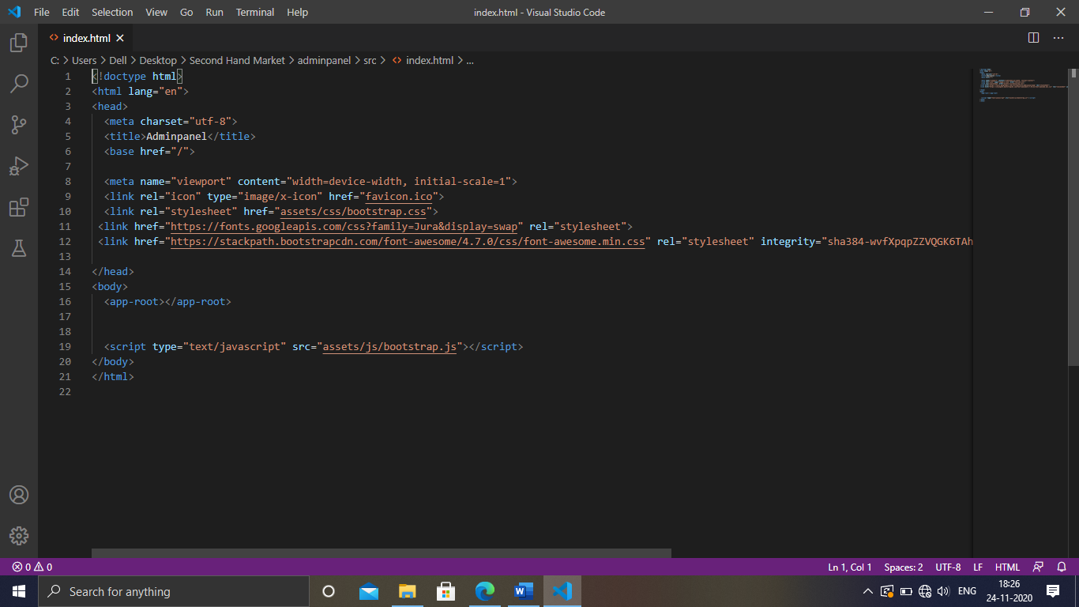
Adding Bootstrap, Fonts and other Styles.
You can add bootstrap, fonts, Styles etc to Adminpanel/src/app/index.html file as shown below.

Slide 13
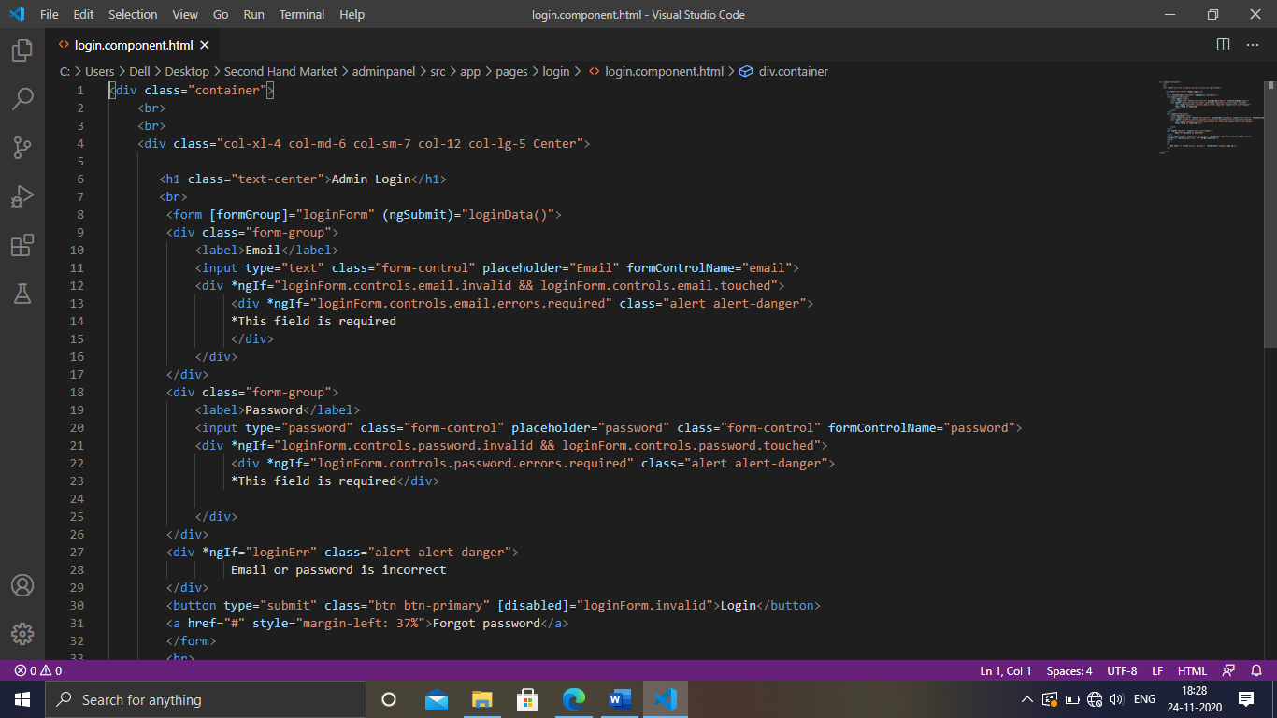
All set up let's design the login page UI
The code below shows the UI design for login page.

Slide 14
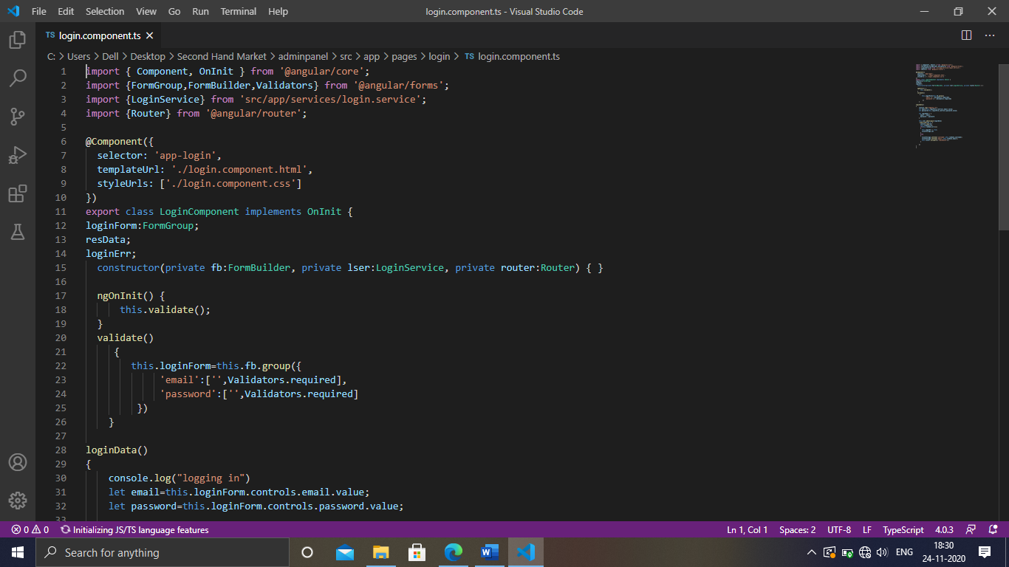
Login.component.ts
Here We have used Reactive form Validation to validate the form data and http services to post and request data from backend .

Slide 15
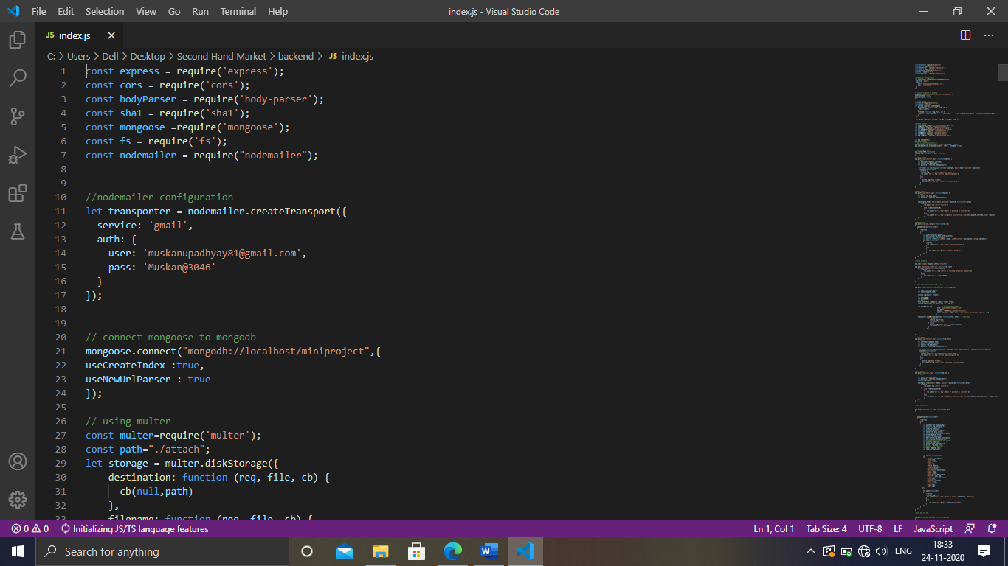
Backend Api file to handle all the database requests
Below is a code snippet of the backend api file to handle all the database related queries.

Slide 16
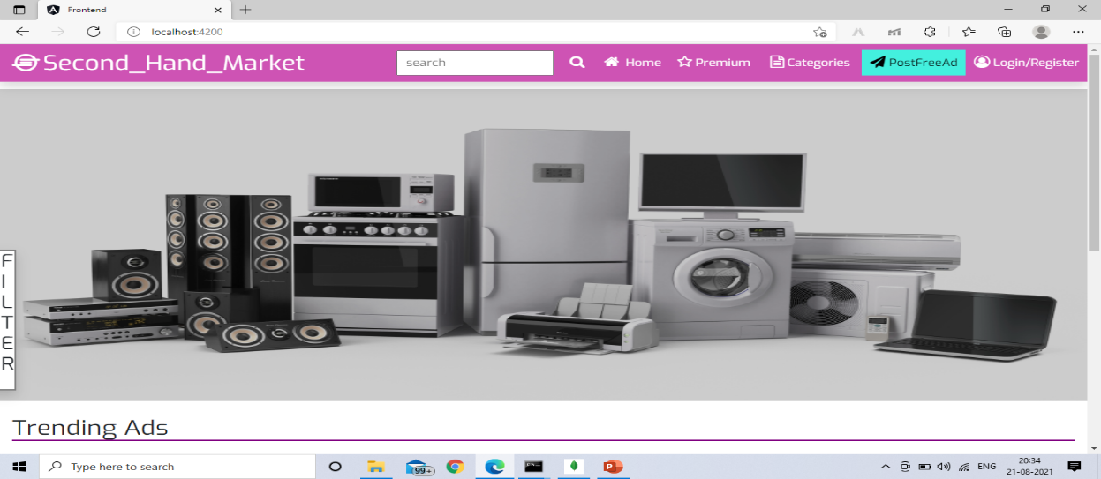
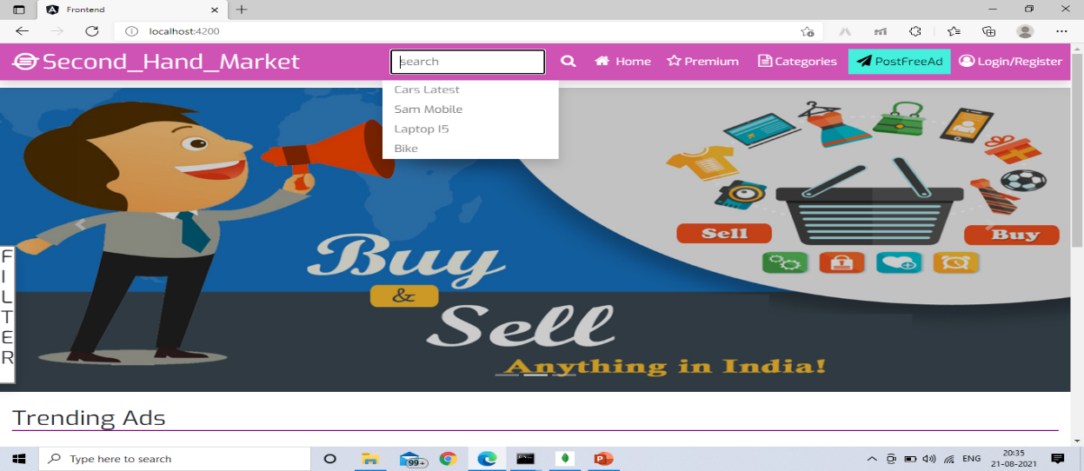
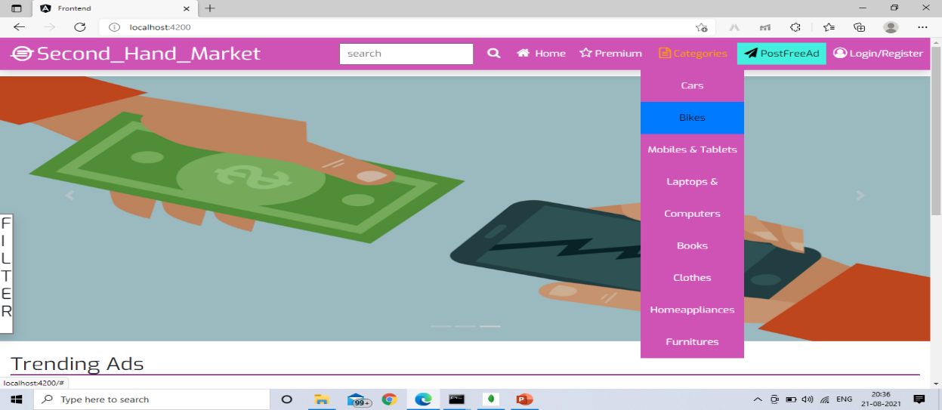
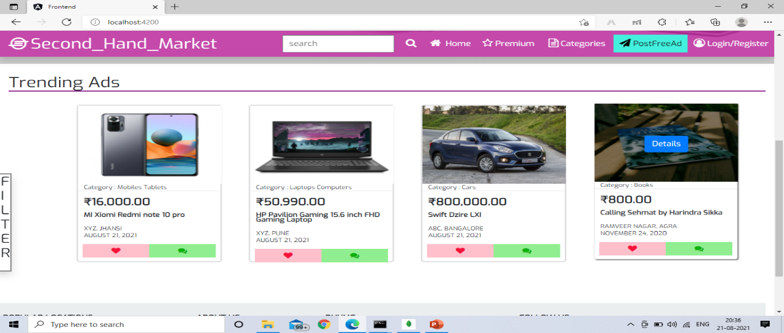
Let's have a look at our main Website...

Slide 17
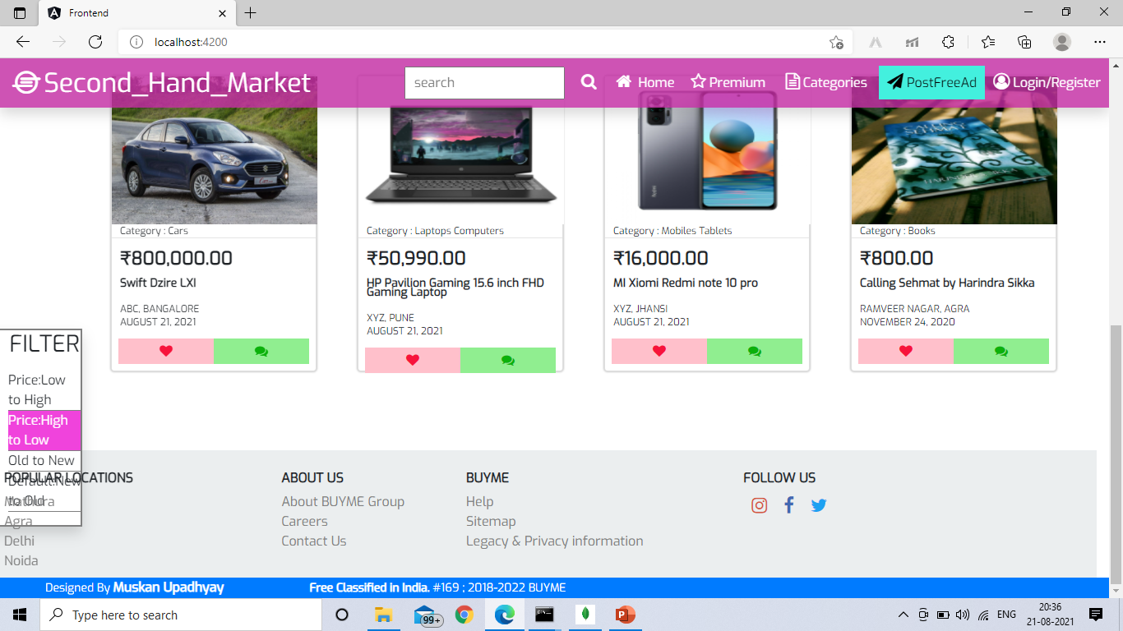
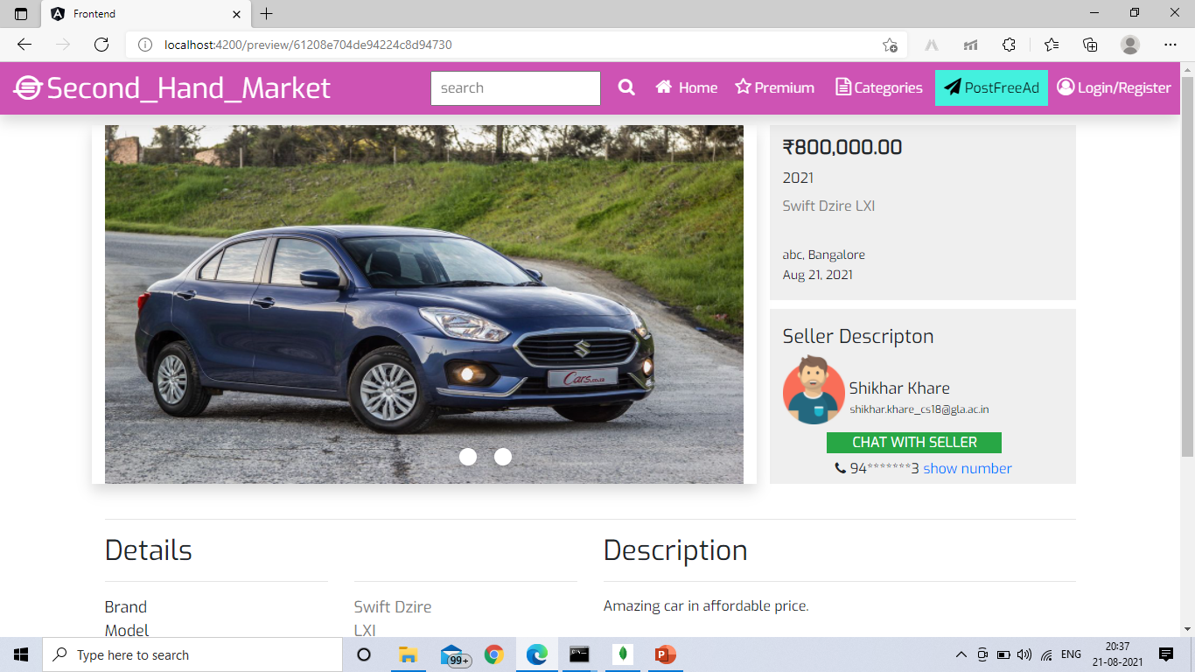
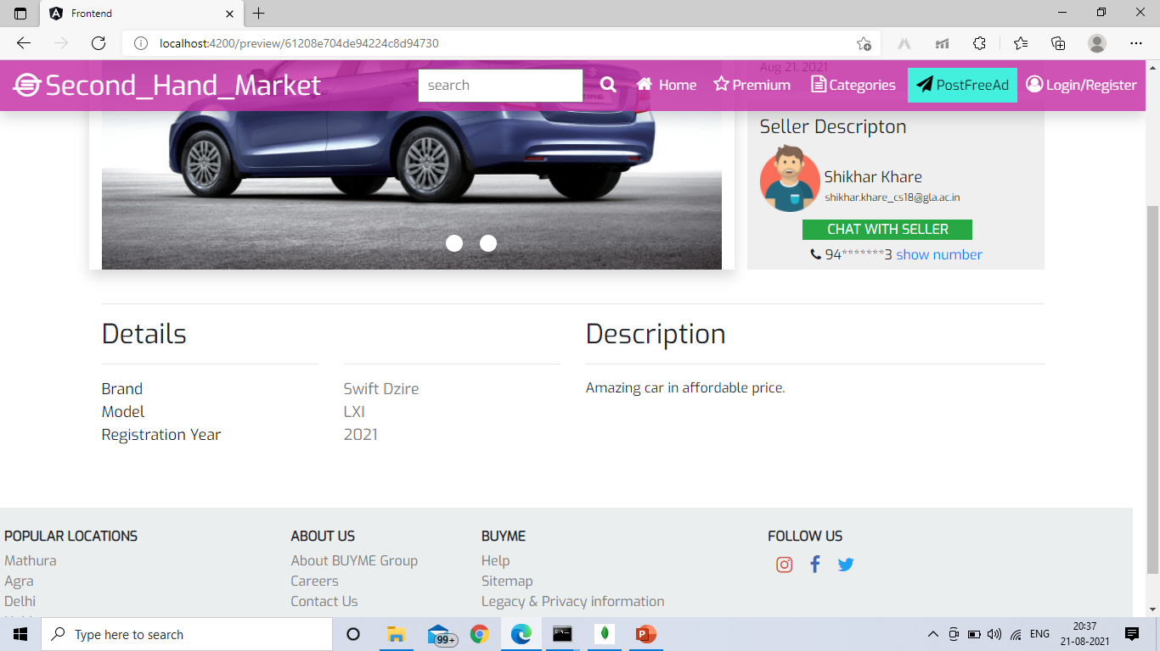
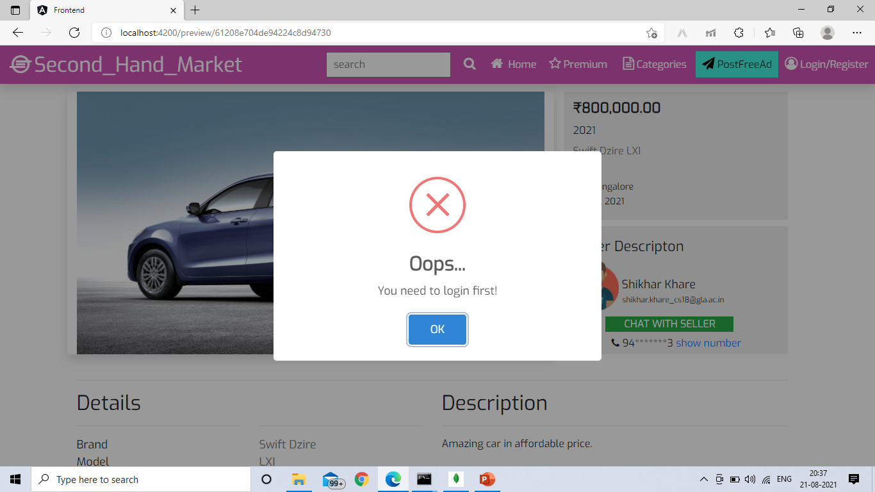

Slide 18
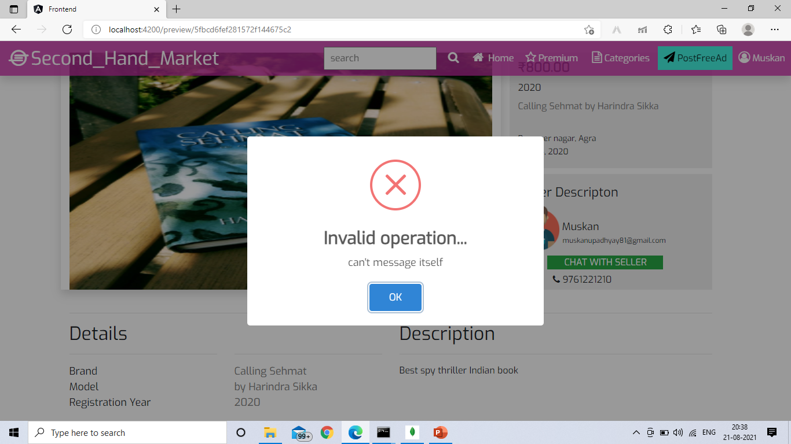
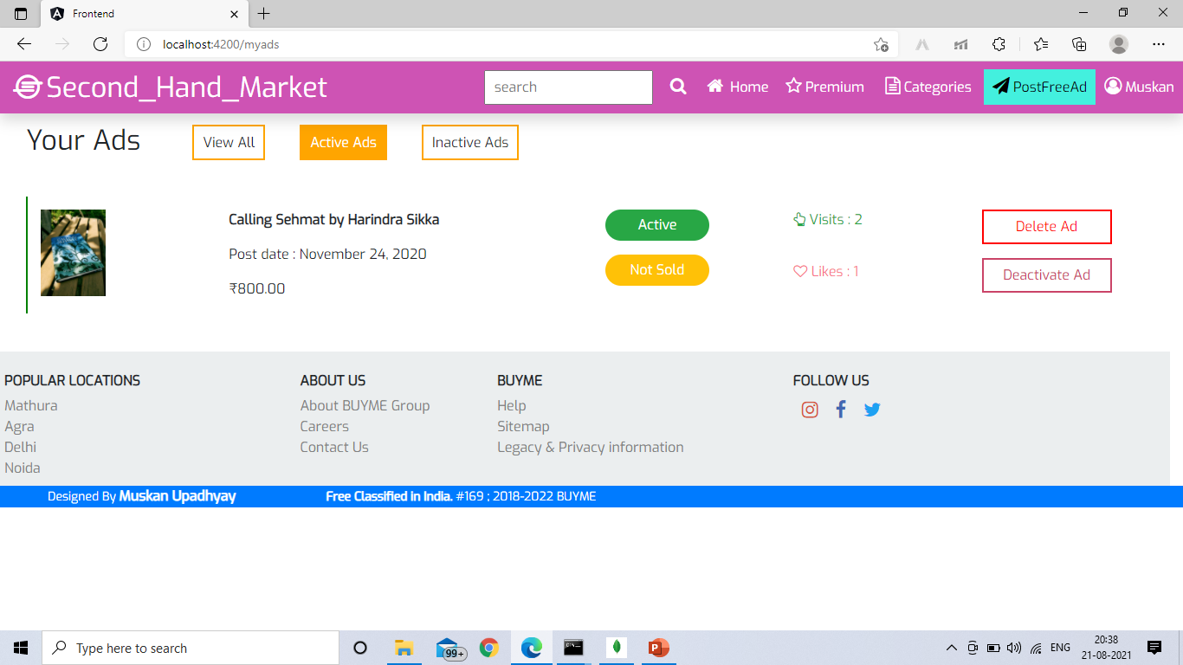
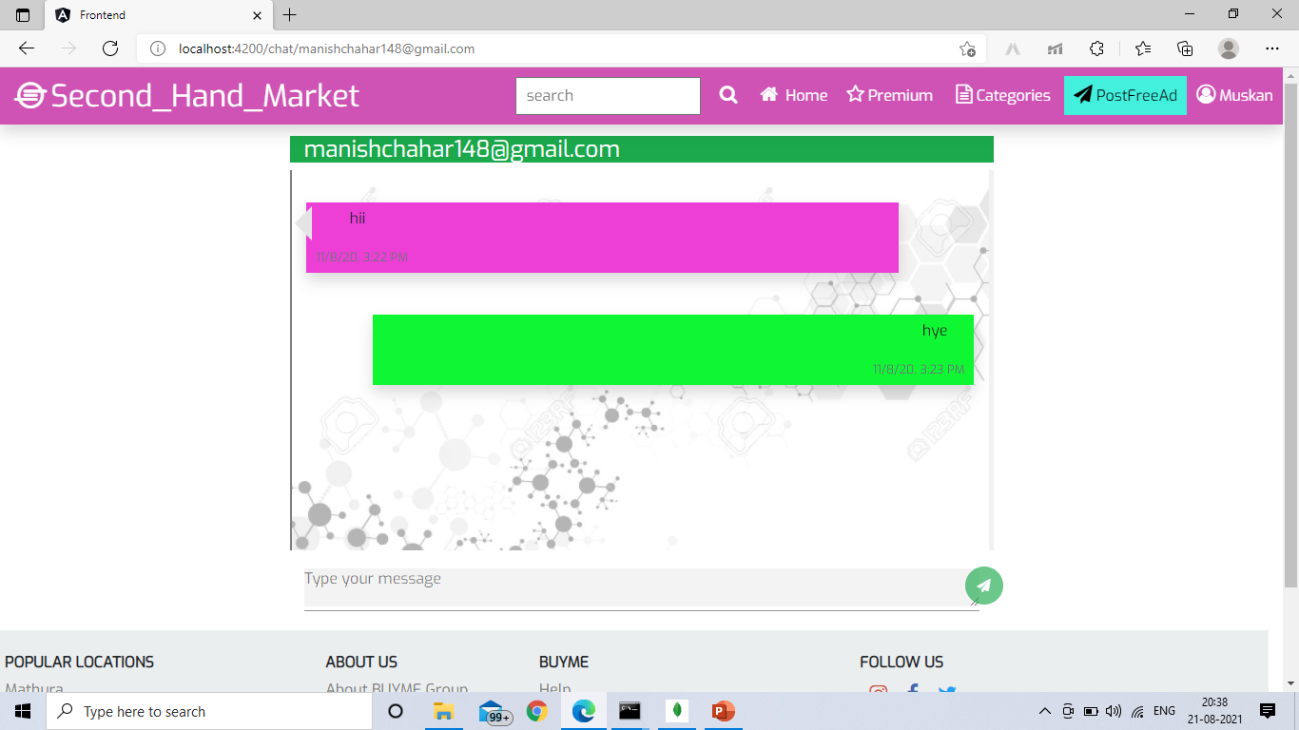
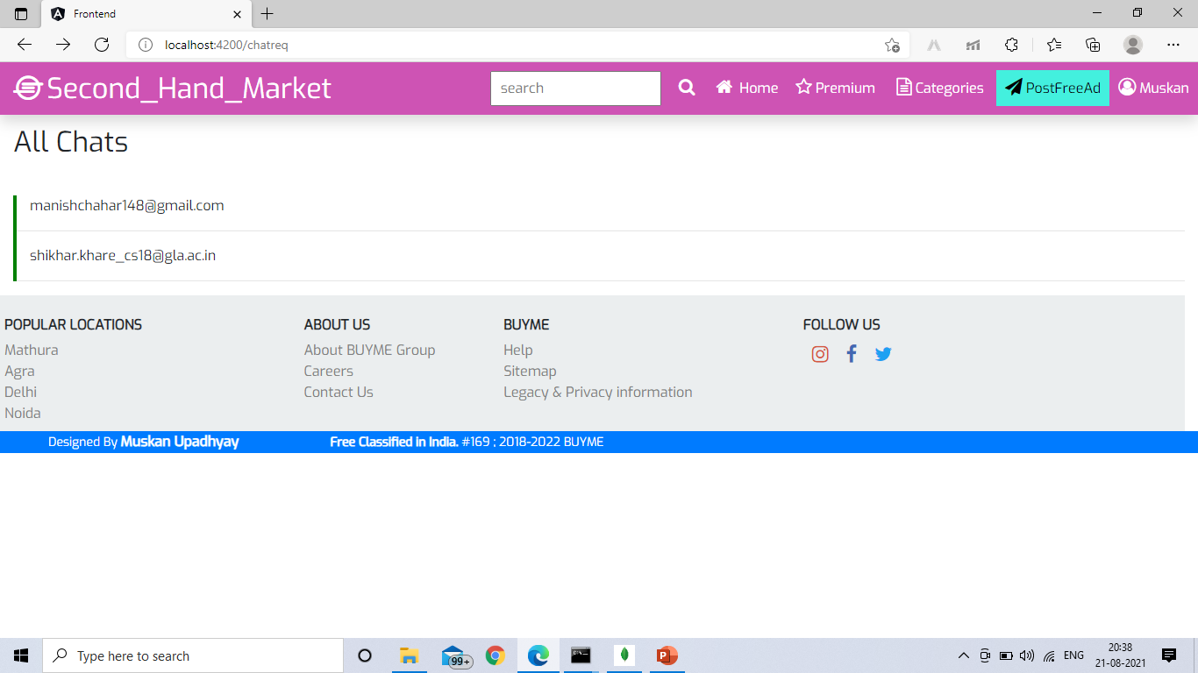

Slide 19
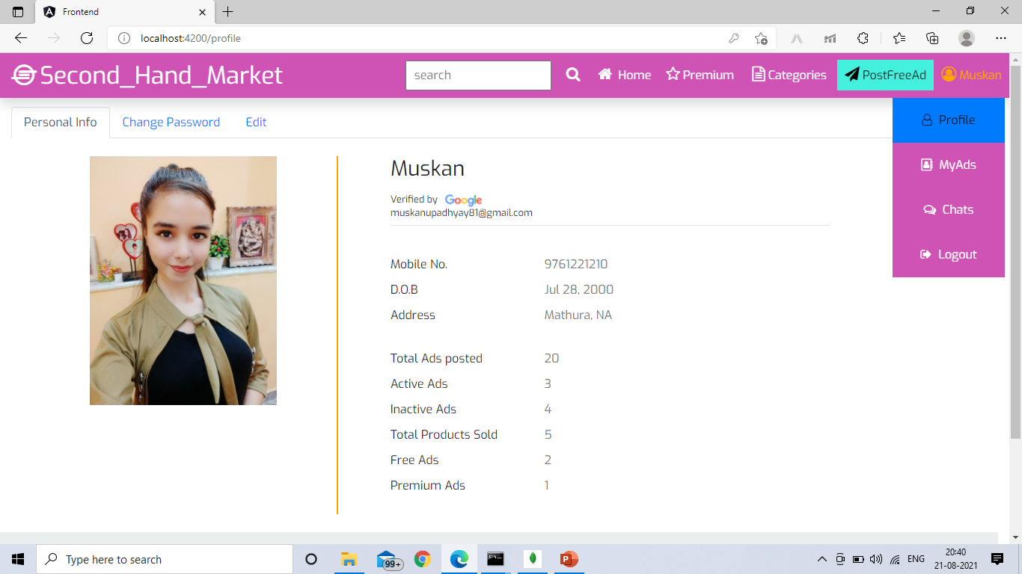
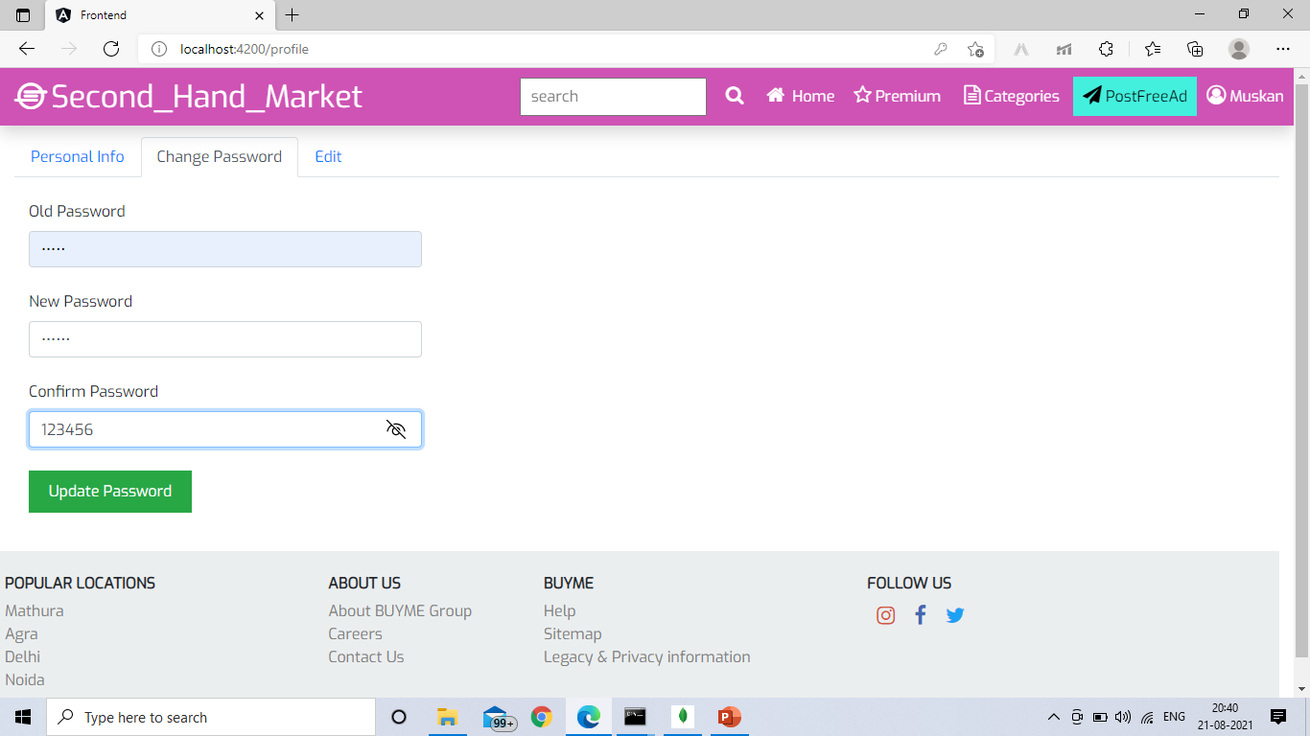
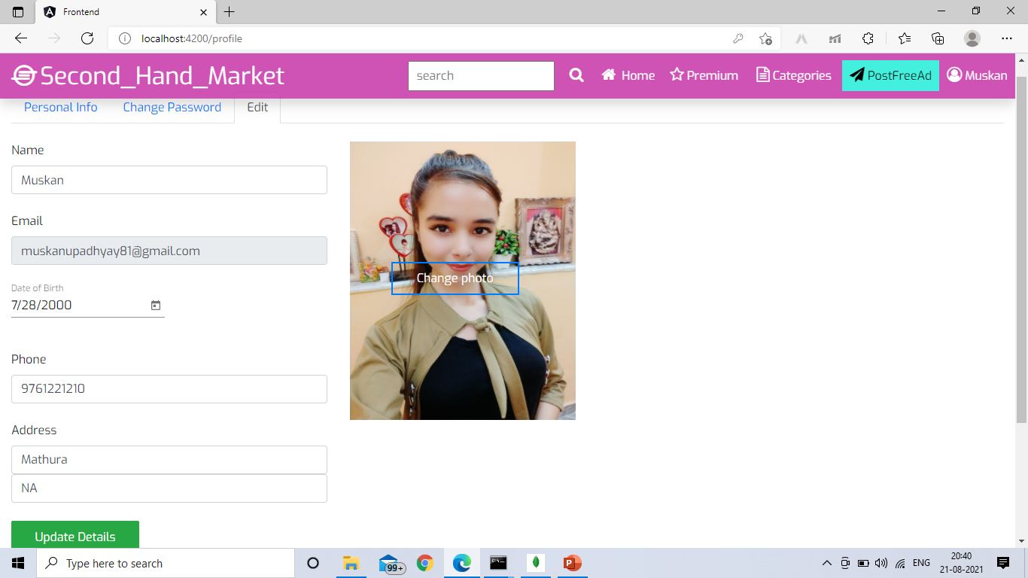
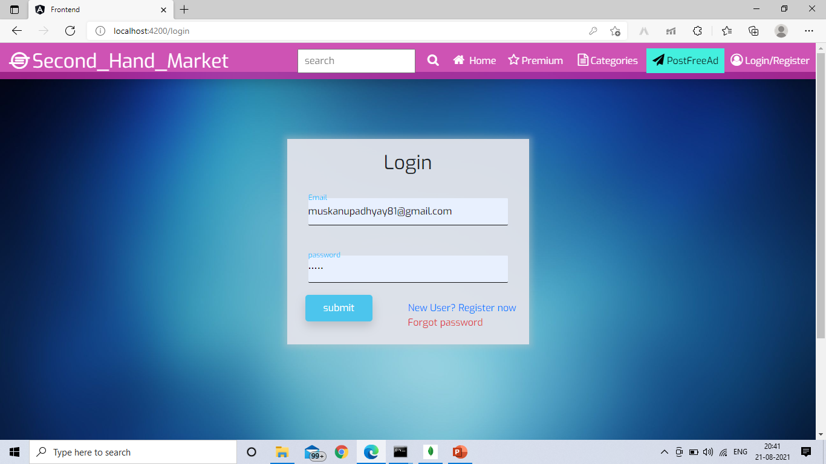

Slide 20
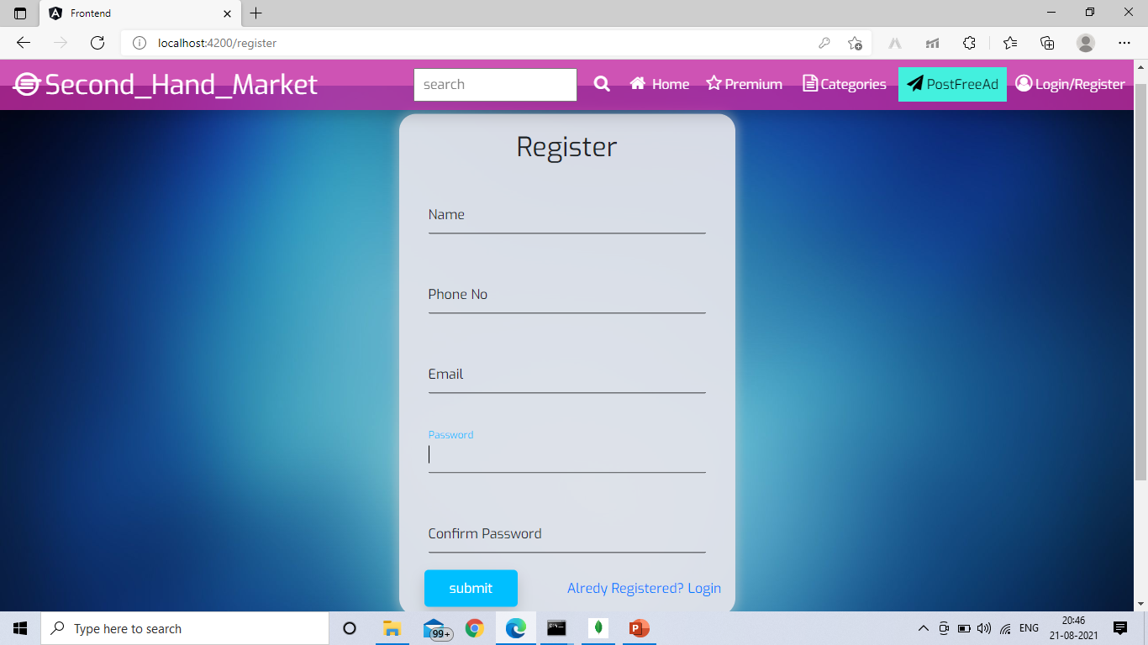
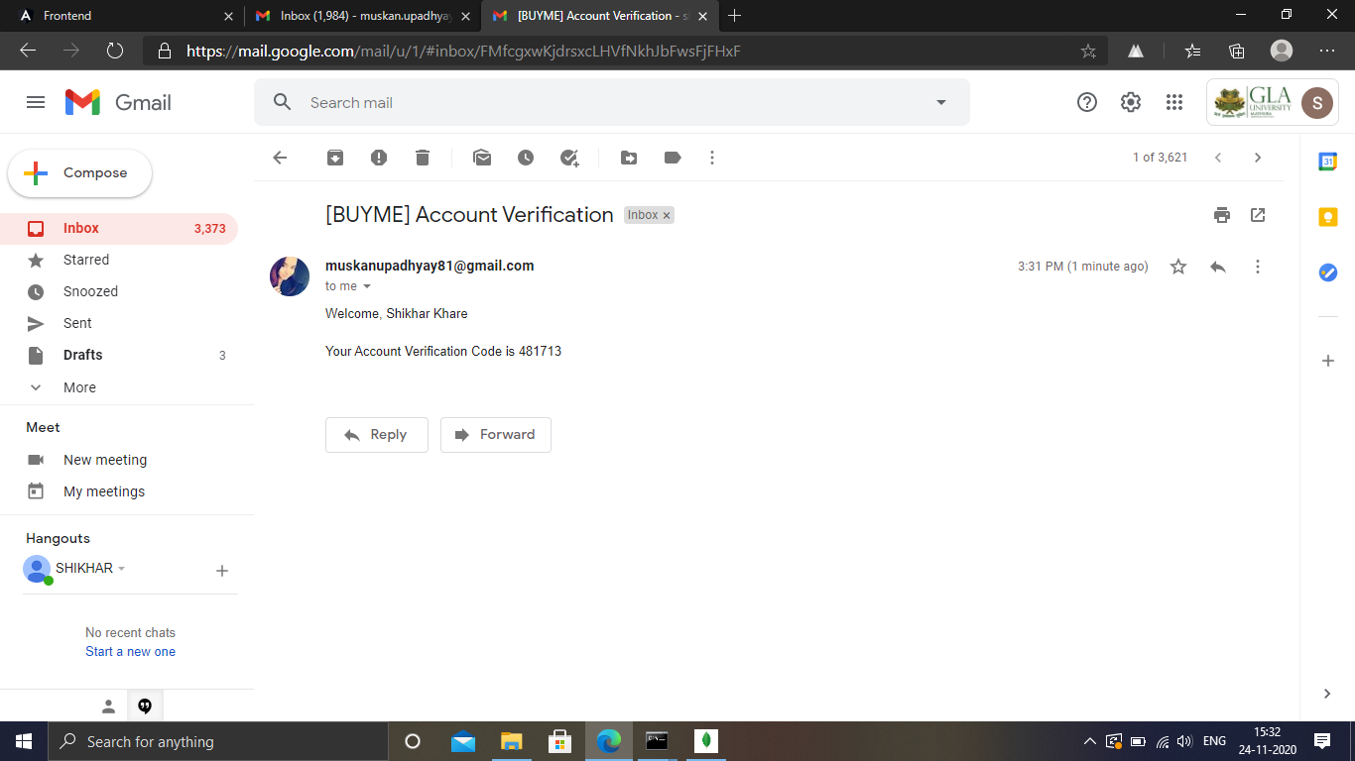
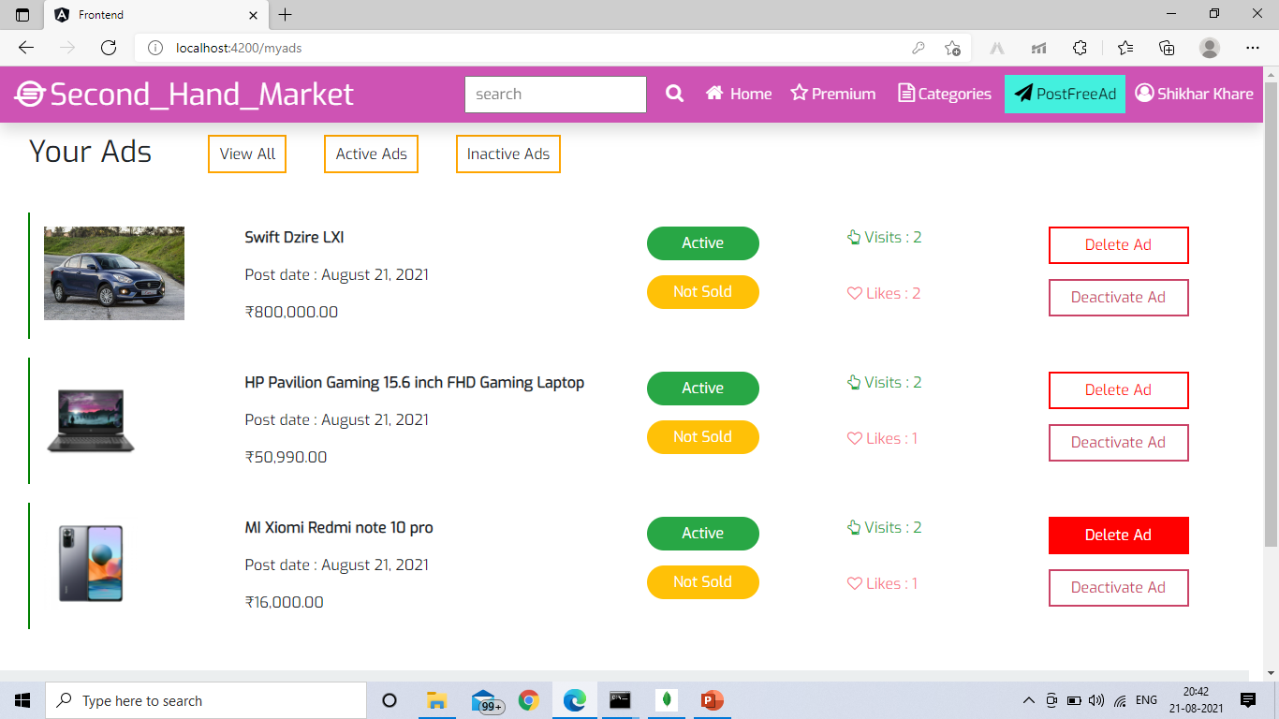
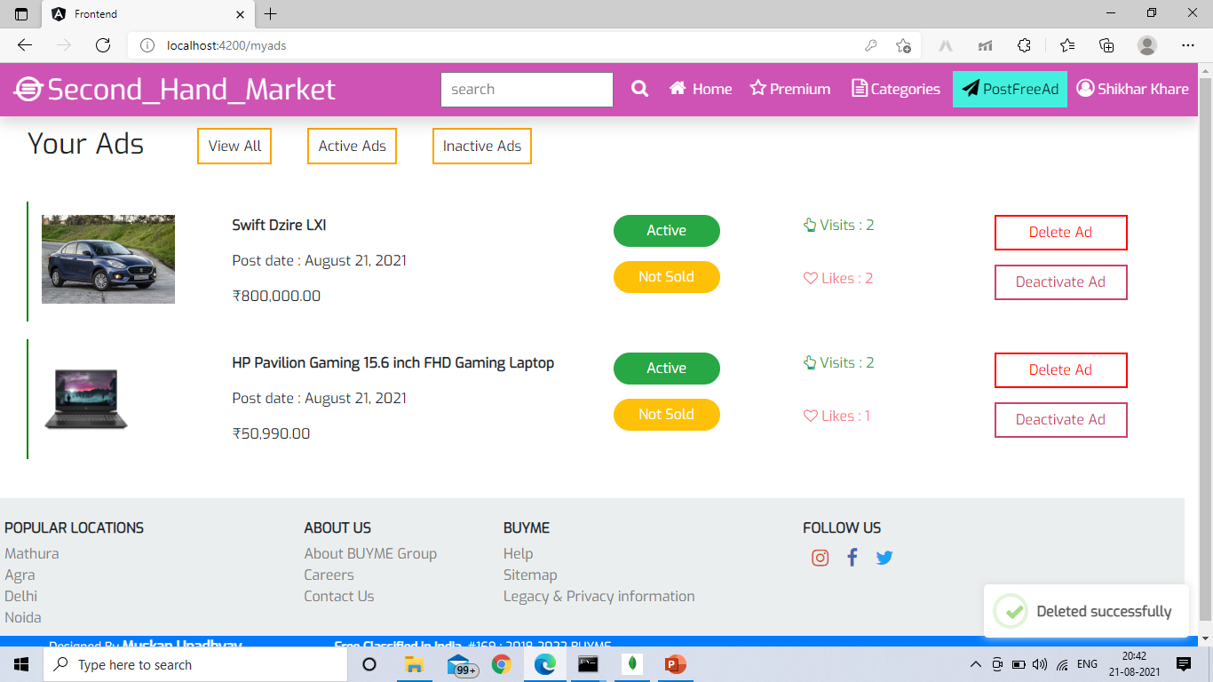

Slide 21
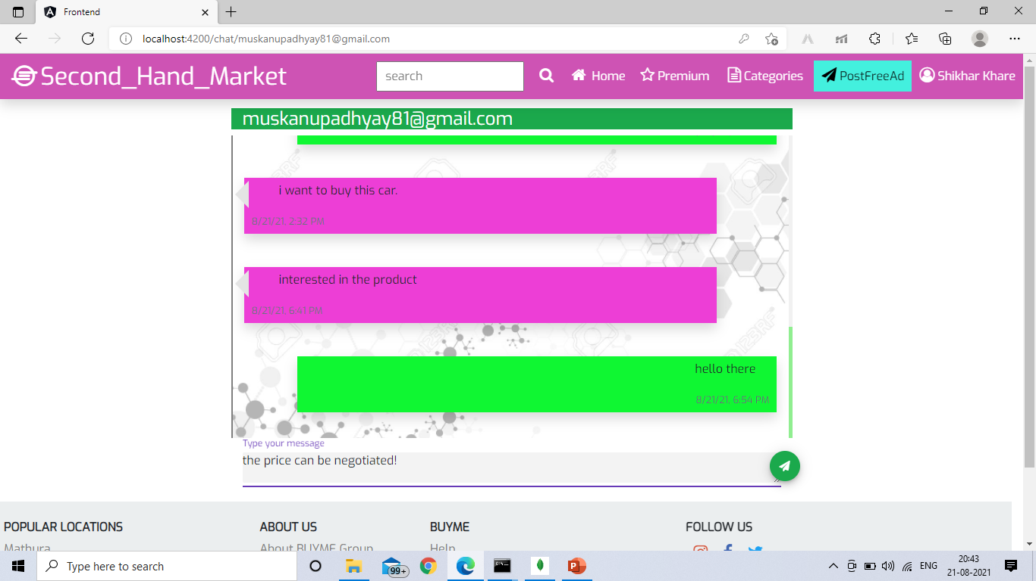
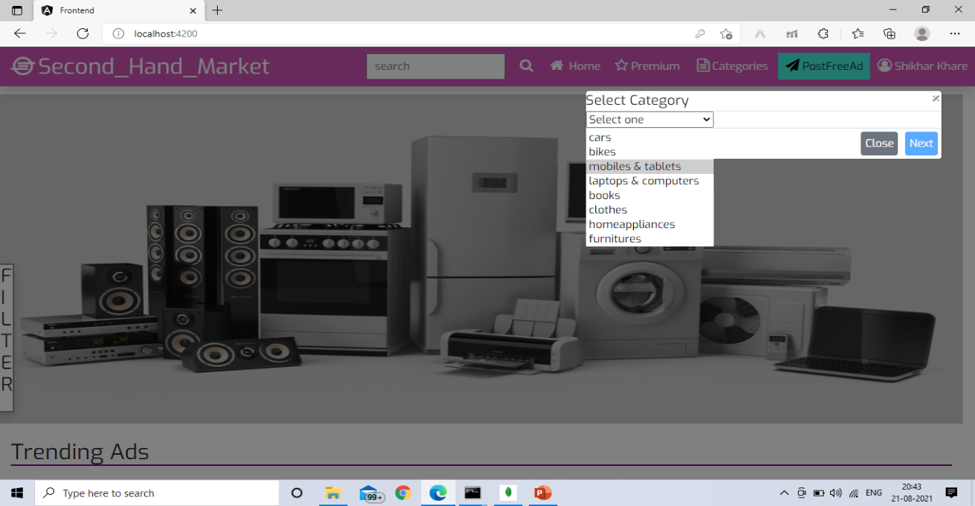
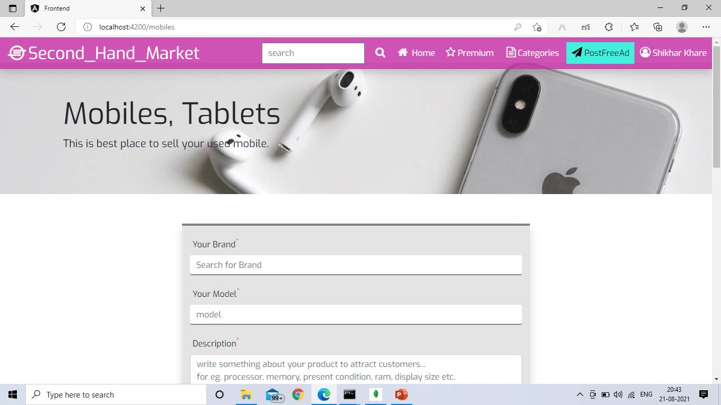
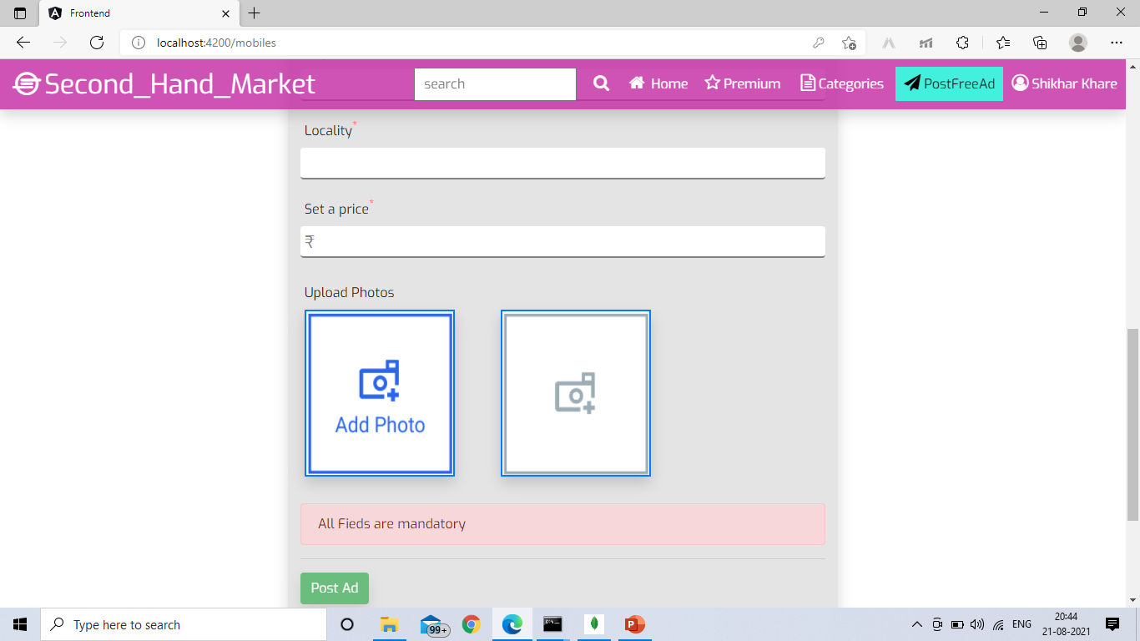

Slide 22
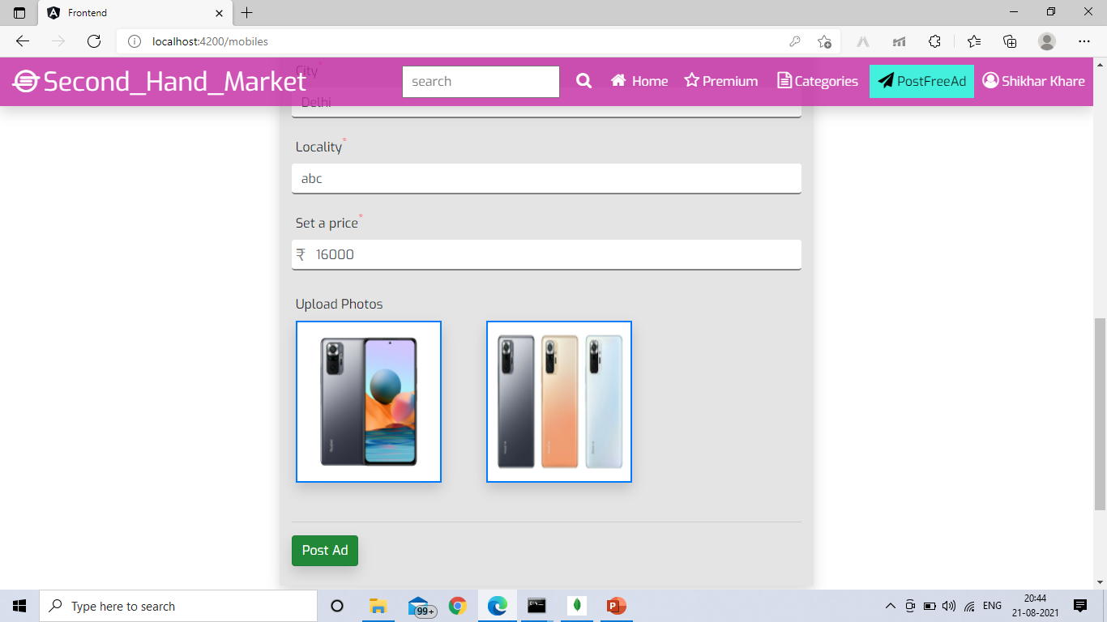
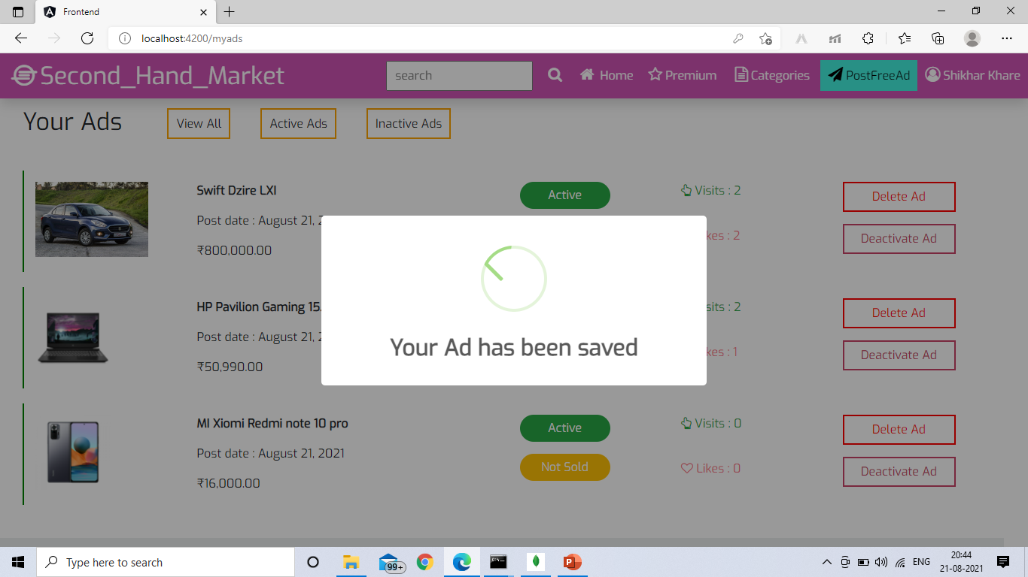
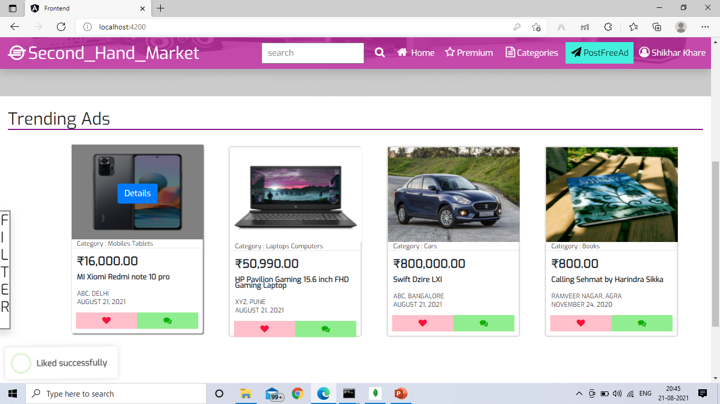
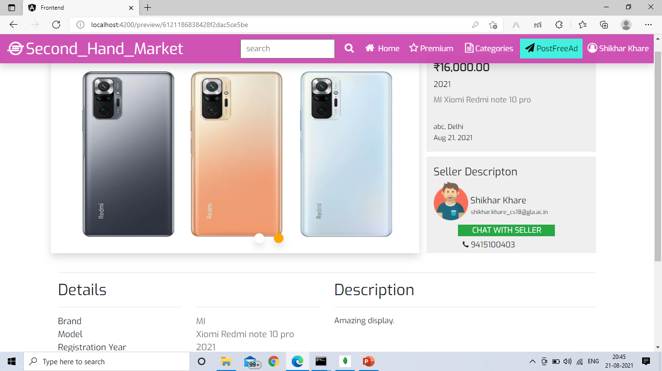

Slide 23


